Slide 1
There are 2 types of AI
ALMOST NO PROGRESS
ANI
Artificial Narrow Intelligence
AGI
Artificial General Intelligence
LOTS OF PROGRESS
Notes:
There is a lot of excitement but also a lot of unnecessary hype about AI.
AI is actually two separate ideas.

Slide 2
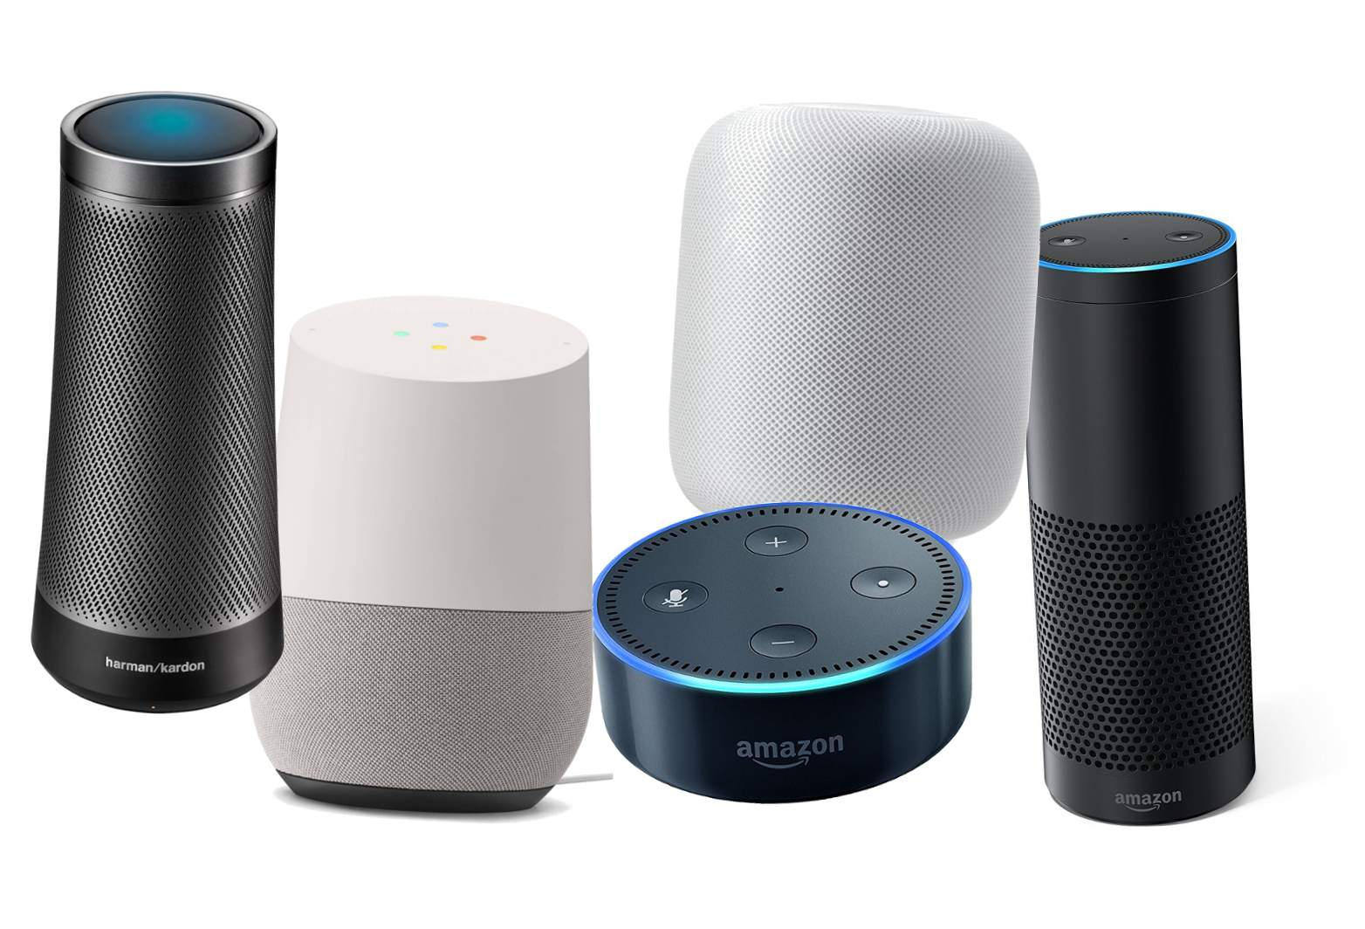
Artificial Narrow Intelligence (ANI)
These are AIs that do one thing such as:
smart speaker
self-driving car
AI to do web search
AI applications in farming or in a factory.
These types of AI are one trick ponies but when you find the appropriate trick, this can be incredibly valuable.

Slide 3

Artificial General Intelligence (AGI)
That is the goal to build AI.
They can do anything a human can do or maybe even be superintelligent and do even more things than any human can.

Slide 4
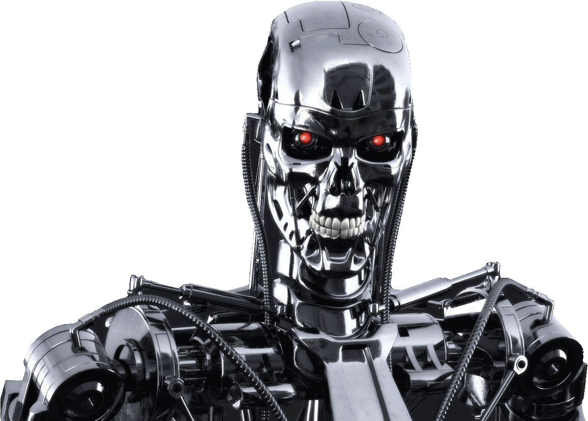
Progress in ANI vs AGI
The rapid progress in ANI has caused people to conclude that there's a lot of progress in AI, which is true. But that has caused people to falsely think that there might be a lot of progress in AGI as well which is leading to some irrational fears about evil clever robots coming over to take over humanity anytime now.

Slide 5
Achieving AGI Will Take Time
AGI is an exciting goal for researchers to work on, but it requires many technological breakthroughs before we get there and it may be decades or hundreds of years or even thousands of years away.

Slide 6
Machine Learning
The rise of AI has been largely driven by one tool in AI called machine learning.
You will start thinking how machine learning might be applied to your company or to your industry.

Slide 7



Supervised Learning
If the input is an audio clip, and the AI's job is to output the text transcript, then this is speech recognition.
Input (A)
Audio
Output (B)
Text (0/1)
Application
Speech Recognition

Slide 8



Supervised Learning
If you want to input English and have it output a different language, Chinese, Spanish, something else, then this is machine translation.
Input (A)
English
Output (B)
Chinese
Application
Machine Translation

Slide 9


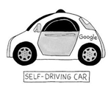

Supervised Learning
If you want to build a self-driving car, one of the key pieces of AI is the AI that takes as input an image, and some information from radar, or from other sensors, and outputs the position of other cars, so your self-driving car can avoid the other cars.
Input(A)
Image, radar info
Position of other cars
Self-Driving Car

Slide 10

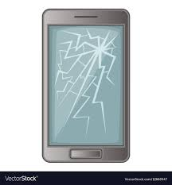
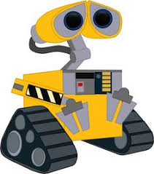
Supervised Learning
In Manufacturing, we take as input a picture of something you've just manufactured, such as a picture of a cell phone coming off the assembly line., and you want to output, is there a scratch, or is there a dent, or some other defects on this thing you've just manufactured? This is visual inspection which is helping manufacturers to reduce or prevent defects in the things that they're making.
Input (A)
Image of a phone
Output (B)
Defects (0/1)
Visual Inspection

Slide 11
Supervised Learning
This set of AI called supervised learning, just learns input to output, or A to B mappings. On one hand, input to output, A to B it seems quite limiting. But when you find a right application scenario, this can be incredibly valuable.

Slide 12
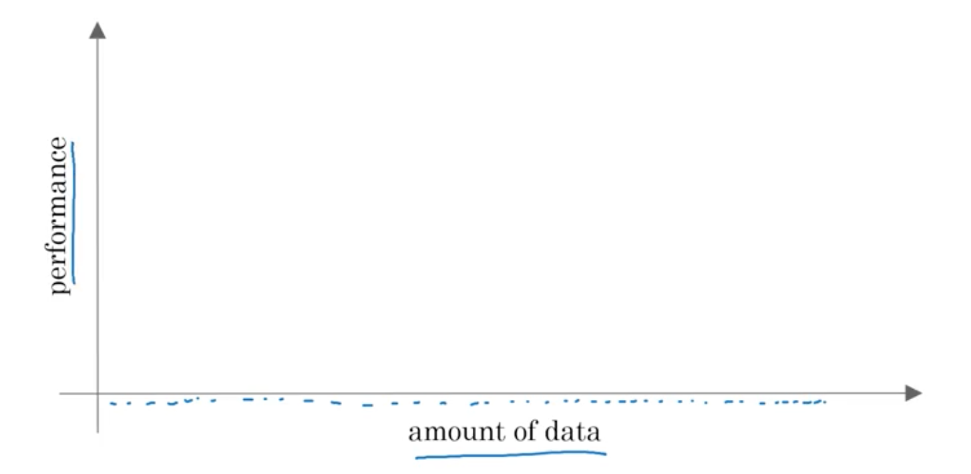
Why Now?

Slide 13
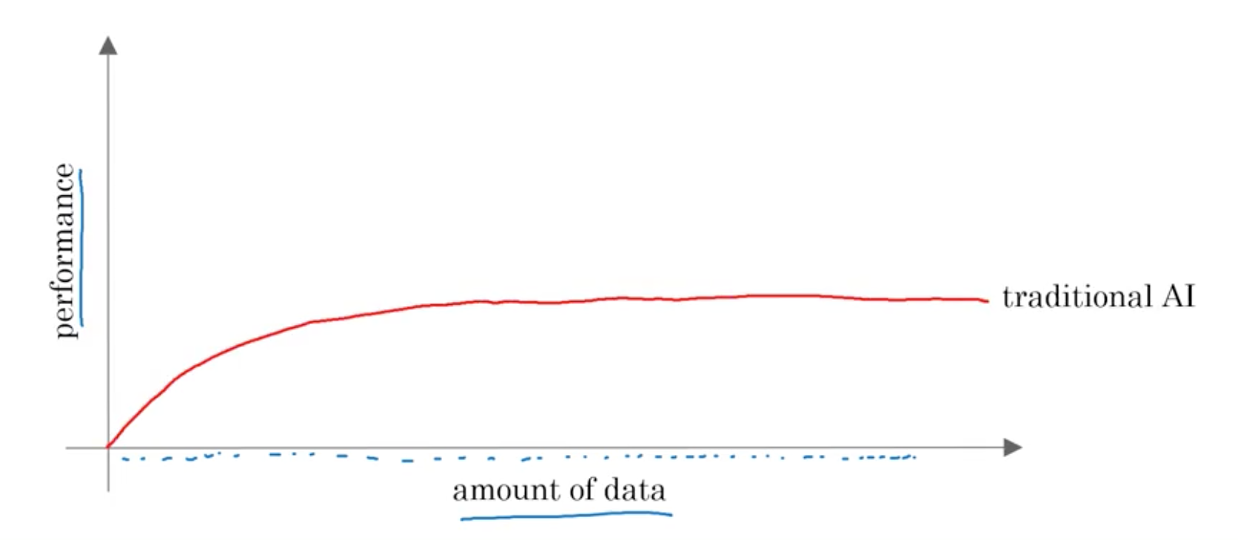
Why Now?

Slide 14
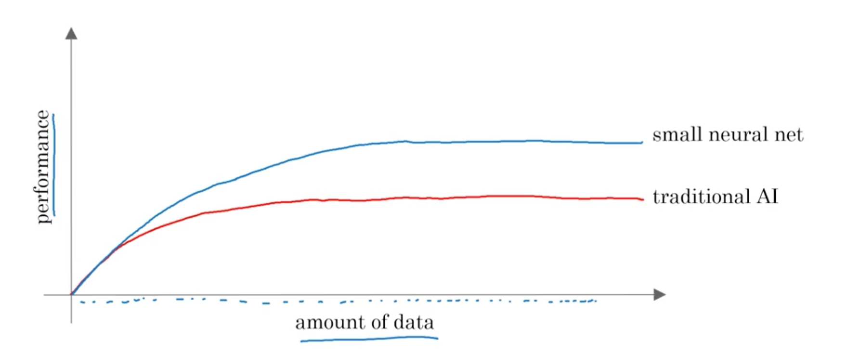
Why Now?

Slide 15
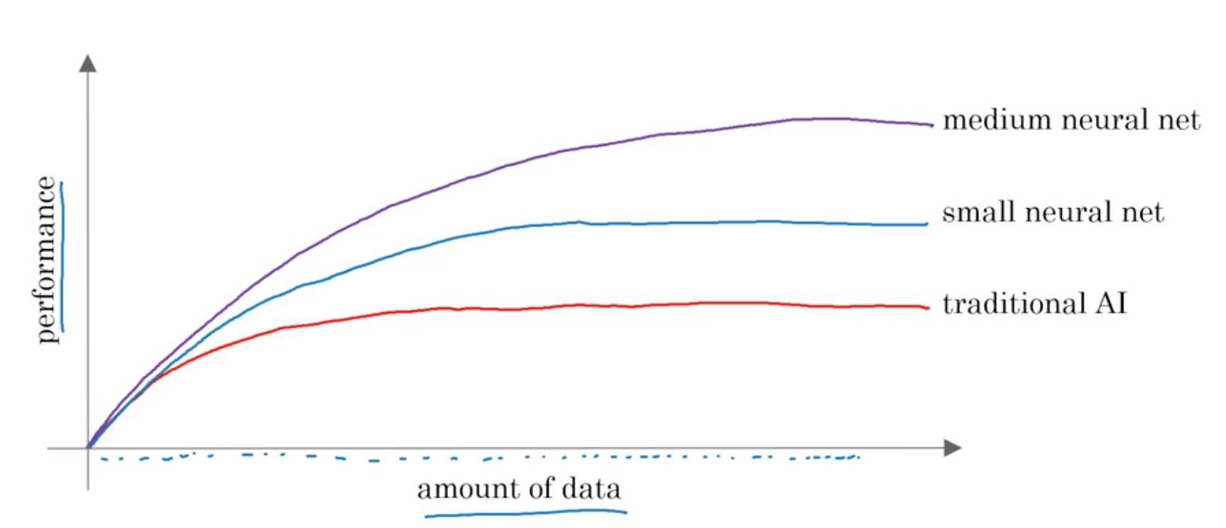
Why Now?

Slide 16
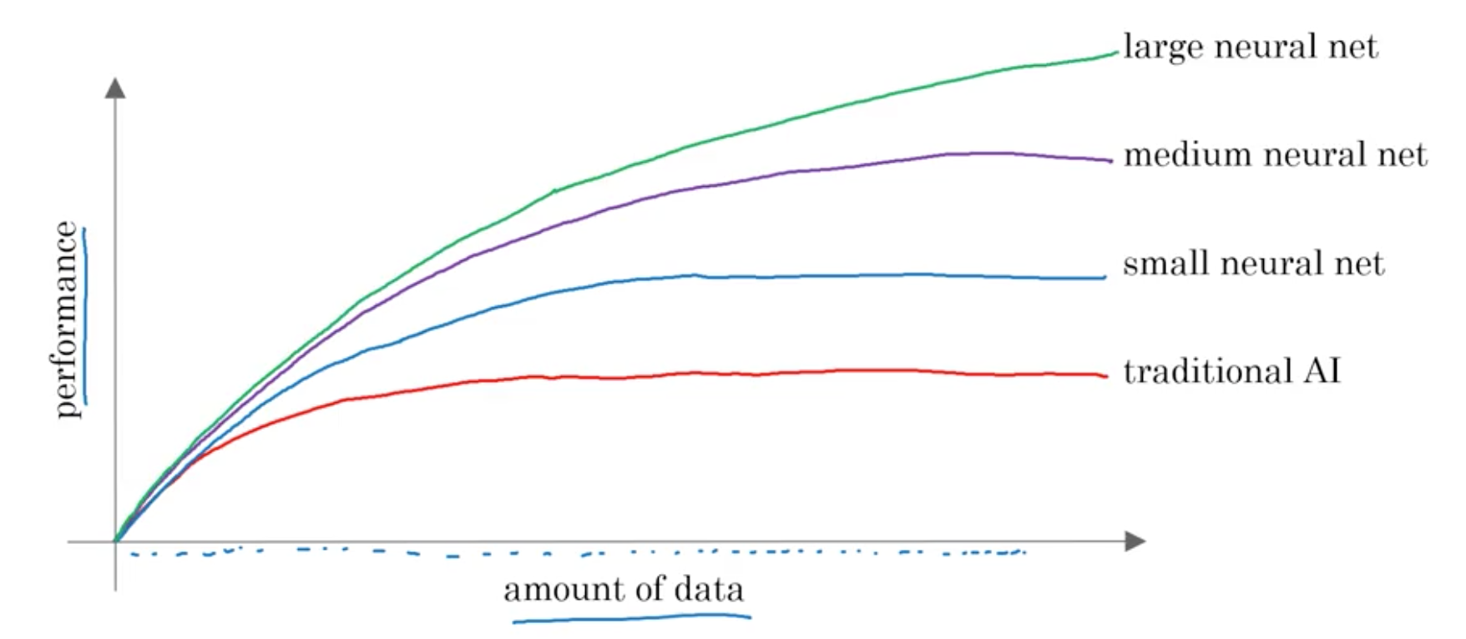
Why Now?

Slide 17
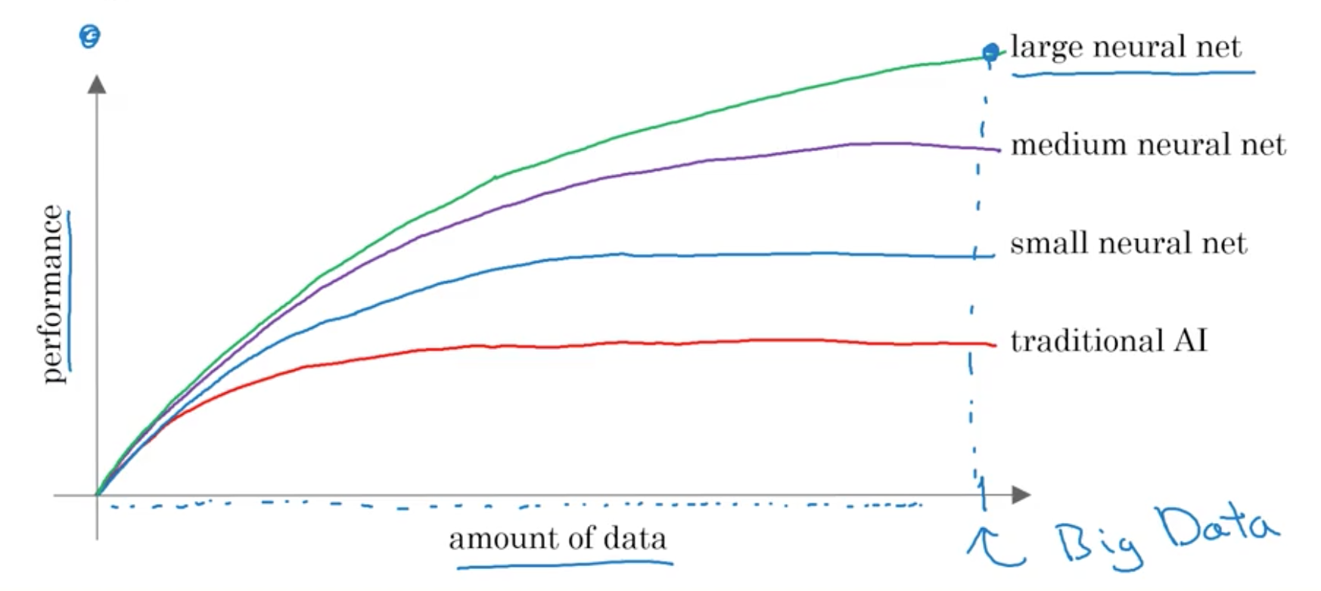
Why Now?

Slide 18
What is the most important
idea in AI?

Slide 19
Machine Learning

Slide 20
What is Supervised Learning?

Slide 21
A to B mappings
Input to Output mappings

Slide 22
What enables machine learning
to work so well?

Slide 23
What is Data

Slide 24
A Table of Data (Dataset)
Size of House (Square Feet) | Price ($1000)
523 | 115
645 | 150
708 | 210
1034 | 280
2290 | 355
2545 | 440
A | B

Slide 25
A Table of Data (Dataset)
Size of House (Square Feet) | # of Bedrooms | Price ($1000)
523 | 1 | 115
645 | 1 | 150
708 | 2 | 210
1034 | 3 | 280
2290 | 4 | 355
2545 | 4 | 440
A |  | B

Slide 26
Data is often unique to your business
Data is often unique to your business, and this is an example of a dataset that a real estate agency might have that they tried to help price houses.
It's up to you to decide what is A and what is B, and how to choose these definitions of A and B to make it valuable for your business.

Slide 27
Another example
If you have a certain budget and you want to decide what is the size of house you can afford, then you might decide that the input A is how much does someone spend and B is just the size of the house in square feet, and that would be a totally different choice of A and B that tells you, given a certain budget, what's the size of the house you should be maybe looking at.

Slide 28
A Table of Data (Dataset)
Size of House (Square Feet) | # of Bedrooms | Price ($1000)
523 | 1 | 115
645 | 1 | 150
708 | 2 | 210
1034 | 3 | 280
2290 | 4 | 355
2545 | 4 | 440
B |  | A

Slide 29

Acquiring data
Manual labeling

Slide 30
Acquiring data
From observing behaviors of humans
User ID | Time | Price ($) | Purchased
4783 | Jan 21 08:15.20 | 7.95 | yes
3893 | Mar 3 11:30.15 | 10.00 | yes
8384 | Jun 11 14:15.05 | 9.50 | no
0931 | Aug 2 20:30.55 | 12.90 | yes

Slide 31
Acquiring data
From observing behaviors of machines
Machine | Temperature | Pressure (psi) | Machine Fault
17987 | 60 | 7.65 | N
34672 | 100 | 25.50 | N
08542 | 140 | 75.50 | Y
98536 | 165 | 125 | Y
Input A |  |  | Input B

Slide 32
Acquiring data
Download from websites / partnerships
Thanks to the open internet you can find so many datasets available for free online
Computer vision or image datasets
Self driving car datasets
Speech recognition datasets
Medical imaging datasets
Keep in mind licensing and copyright

Slide 33


Use and misuse of data
Give me three years to build up my IT team, we're collecting so much data.
Then after three years, I'll have this perfect dataset.
We'll do AI then.
What’s wrong with this approach?

Slide 34
Use and misuse of data
It turns out that's a really bad strategy.
Once you've started collecting some data, go ahead and start showing it or feeding it to an AI team.
Then the AI team can give feedback to your IT team on what types of data to collect and what types of IT infrastructure to keep on building.

Slide 35
Example
Maybe an AI team can look at your factory data and say, "Hey. You know what? If you can collect data from this big manufacturing machine, not just once every ten minutes, but instead once every one minute, then we could do a much better job building a preventative maintenance systems for you.”
Machine | Temperature | Pressure (psi) | Machine Fault
17987 | 60 | 7.65 | N
34672 | 100 | 25.50 | N
08542 | 140 | 75.50 | Y
98536 | 165 | 125 | Y
Input A |  |  | Input B

Slide 36
Use and misuse of data
"Hey, I have so much data. Surely, an AI team can make it valuable."
What’s wrong with this statement?

Slide 37
Use and misuse of data
Unfortunately, this doesn't always work out.
More data is usually better than less data, but I wouldn't take it for granted that just because you have many terabytes or gigabytes of data, that an AI team can actually make that valuable.
Don't throw data at an AI team and assume it will be valuable.

Slide 38
Data is Messy
Not a cat
Not a cat
Cat
Cat

Slide 39
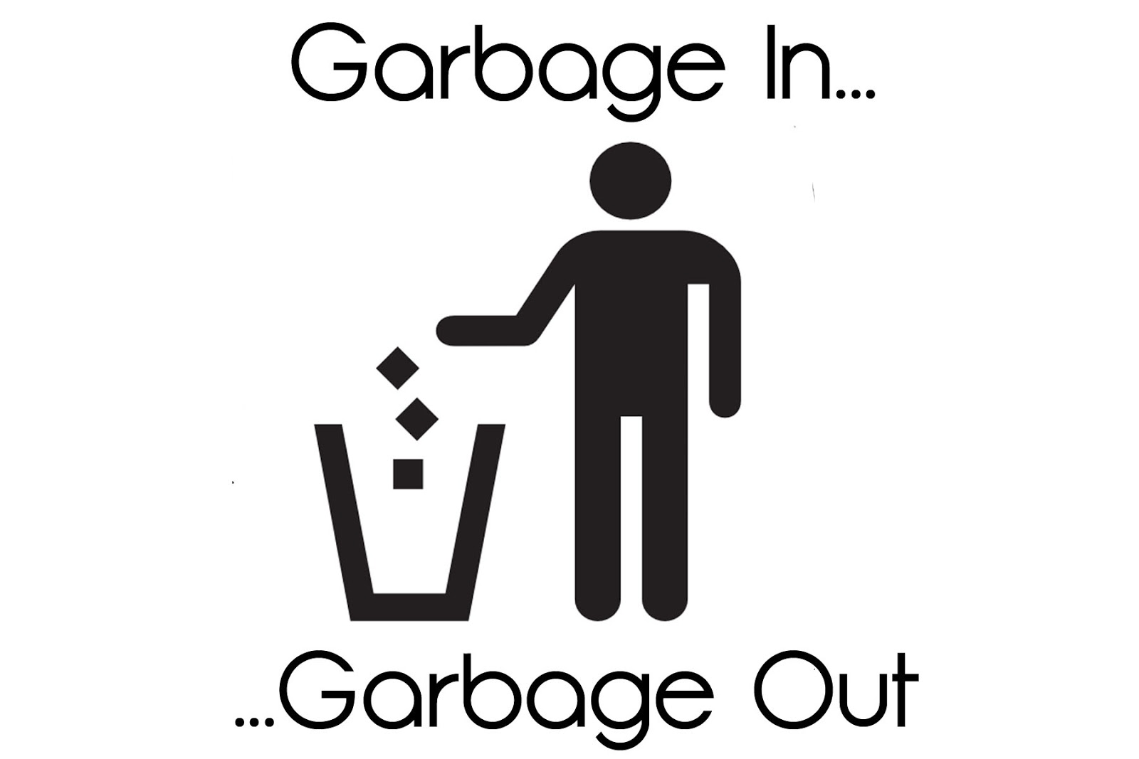
Data is Messy
If you have bad data, then the AI will learn inaccurate things.
Data problems:
Incorrect labels
Missing values
Multiple types of data
Unstructured Data: Images, audio, text

Slide 40
Example
Size of House (Square Feet) | # of Bedrooms | Price ($1000)
523 | 1 | 115
645 | 1 | 0.001
708 | unknown | 210
1034 | 3 | unknown
unknown | 4 | 355
2545 | unknown | 440
You can have incorrect labels or just incorrect data. For example, this house is probably not going to sell for $0.1 just for one dollar.
Or, data can also have missing values such as we have here a whole bunch of unknown values.
This is structured data.

Slide 41
Machine Learning vs Data Science
Size of House (Square Feet) | # of Bedrooms | # of Bathrooms | Newly Renovated | Price ($1000)
523 | 1 | 2 | N | 115
645 | 1 | 3 | N | 150
708 | 2 | 1 | N | 210
1034 | 3 | 3 | Y | 280
2290 | 4 | 4 | N | 355
2545 | 4 | 5 | Y | 440
A |  |  |  | B
Notes:
Mobile App to help people price houses
Machine Learning system: A > B

Slide 42
Machine Learning vs Data Science
Machine Learning
“Field of study that gives computers the ability to learn without being explicitly programmed.”
Arthur Samuel (1959)
A machine learning project will often result in a piece of software that runs, that outputs B given A.

Slide 43
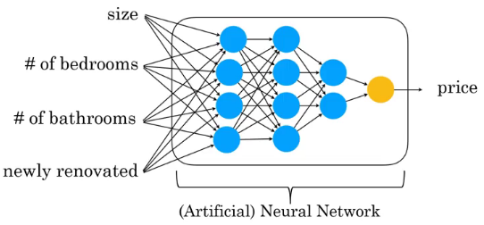
Deep Learning

Slide 44
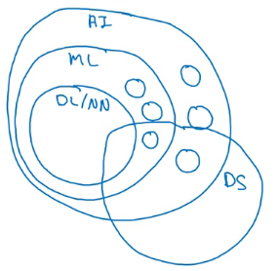
AI and related disciplines
Machine Learning
Data Science
Deep Learning / Neural Network
Supervised Learning
Un supervised learning
Reinforcement Learning

Slide 45
Deciding about a new project
Technical diligence
Is it feasible project?
Can AI do that?
Pretty much any thing you can do with a second of thought can be automated using supervised learning

Slide 46
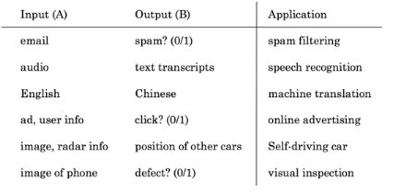
Supervised learning tasks

Slide 47
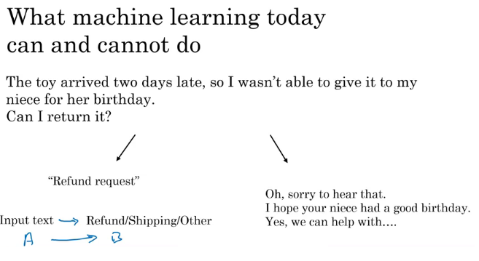

Slide 48
Examples of what ML can and can’t do?
Identifying the intent of the customer - Possible
Writing an emphatic response to customer’s email – Not possible or difficult

Slide 49
Strengths and weakness of ML
Works when,
Learning a simple concept
Lots of data available
Doesn’t work when,
Learning a complex concept
Asked to work on new type of data such as X-ray images in different conditions and angles

Slide 50
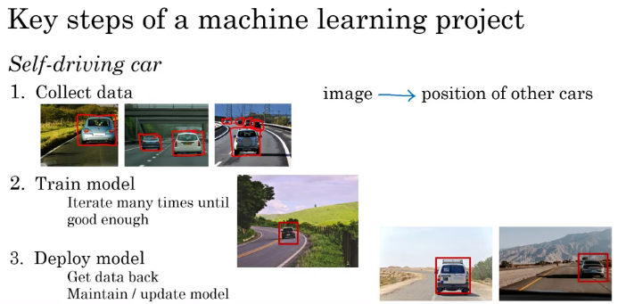

Slide 51
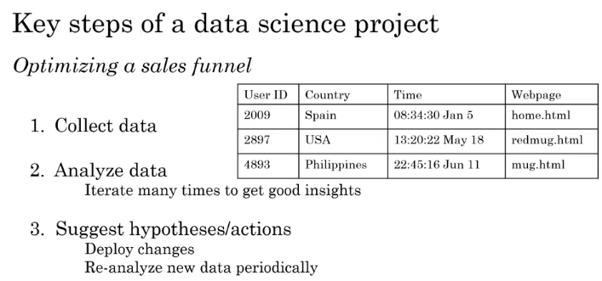

Slide 52
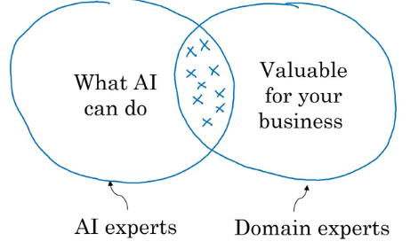
How to chose an AI project?

Slide 53
Is it always necessary to have big data?
Having more data is good
With small datasets you can make progress
10, 100 or 1000 data points can be a good start

Slide 54
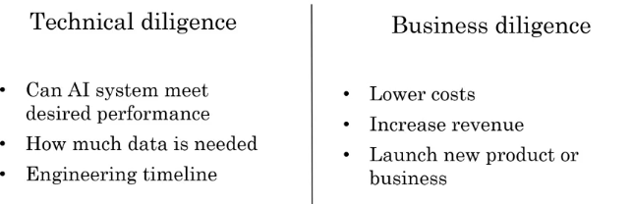

Slide 55
How to work with AI team
Specify your acceptance criteria
95% accuracy
Training, validation and Test dataset
Don’t expect 100% accuracy
Limitations of ML
Insufficient data
Mislabeled data
Ambiguous labels (human perception)

Slide 56
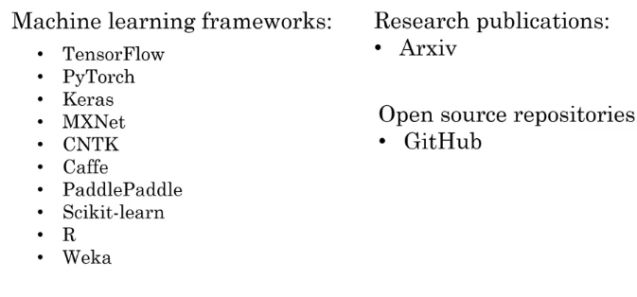
Machine Learning frameworks

Slide 57
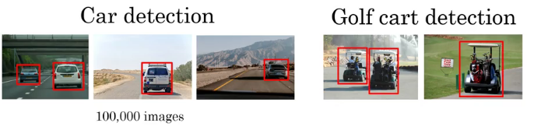
Transfer learning

Slide 58
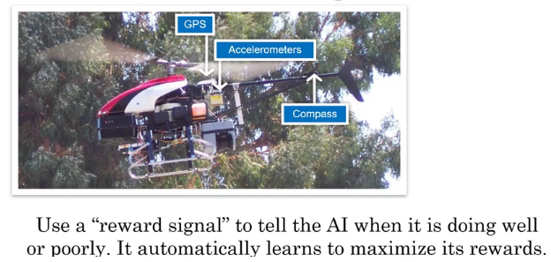
Reinforcement learning
Also useful in Games
Not as much as economic value as supervised learning

